Slide 1
Project Cuboid
Robert Baines, Andrew Morgan, Hayley McClintock

Slide 2
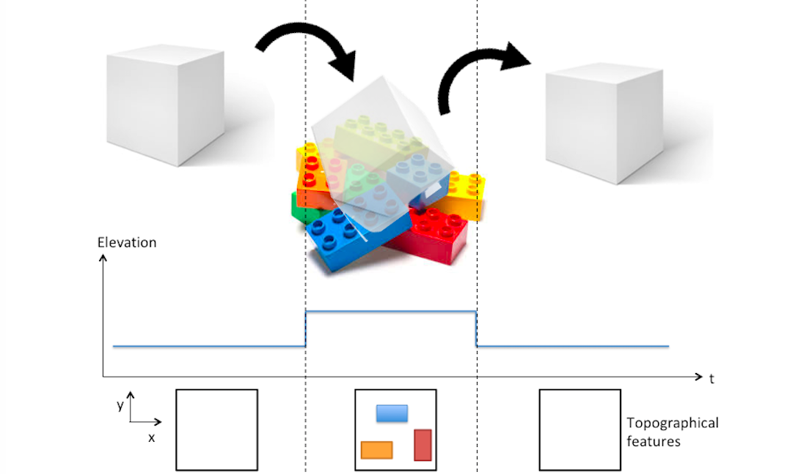
Problem Statement
A cuboid with a dynamic contact surface for adaptable motion and topographic mapping on variable terrains.

Slide 3

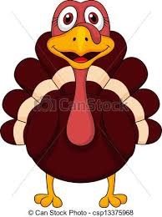

Deliverables
10/12
Order initial testing components
CAD model and design
Electronic architecture diagram
Complete solenoid testing
11/2
Prototype I constructed
Sensor calibration
Testing plan
12/3
Final cube finished
Achieve topographical mapping
Locomote over obstacle course

Slide 4
What we have done
Prototype I in progress (show it)
ROS master architecture done (show it next slide)
Catkin_ws: https://github.com/asmorgan24/project_cuboid
Vision detection algorithm done
Figured out appropriate lighting geometry for shapes by shades
Symmetric on/off average of 4 sides of square
Arduino pressure regulator test code working
Bang bang controller ros node in progress
Testing plan:
Fixed obstacle course on table top: measured object heights and dimensions
Evaluation metric: average mean squared error for each “plot” measurement over course
IEEE format Manuscript started

Slide 5
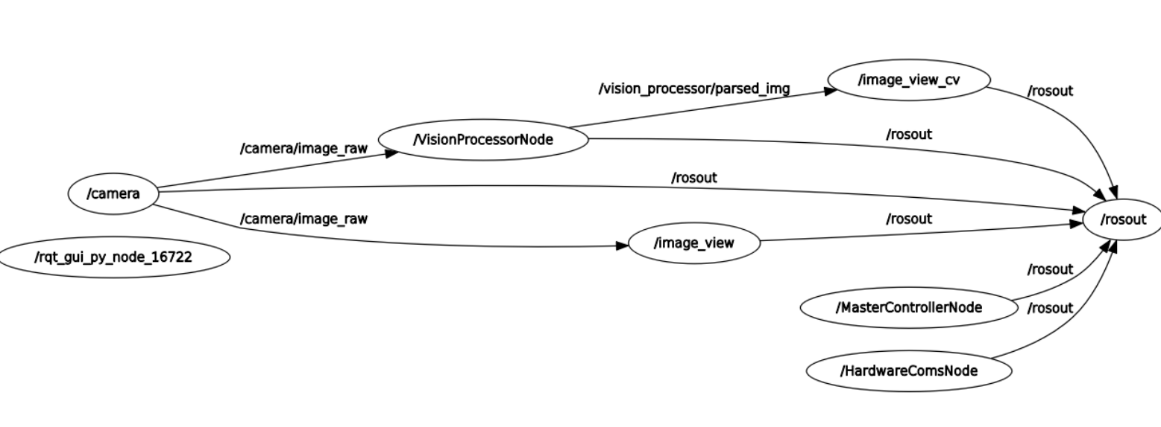

Slide 6
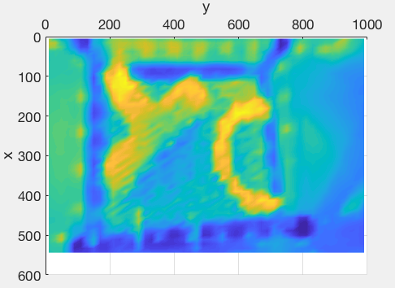
Problems
Rolling the cube
Inflate balloon bends in the wrong direction under the weight of the cube
Pins seem to inhibit motion
Pins on pin art toy are poor quality
We anticipate on running into larger problems with the full prototype
LED array appears in
Field of view. Easy fix via crop

Slide 7
Next steps
Get actuation working
Finish a full prototype
Test cameras and lighting
Prototype camera mounting system
Create wiki page and start populating
Where do we make a wiki page?

